Slide 1
Phonology
Phonetics, Phonetic Script and English Sounds

Slide 2
Phonology and Phonetics
Phonology is the linguistic study of sounds.
Phonology involves the study of linguistic sounds, like the sounds within a word, and the sounds within a sentence etc.
It also involves the study of paralanguage – tone, pitch, stress, intonation and so on.
Phonetics is the study of linguistic sounds, or the sounds made by alphabets.
Phonetics involve the study of phonemes- a phoneme is the smallest unit of sound, for example, /p/, /b/, /t/, /d/ etc.

Slide 3
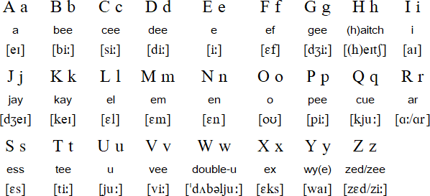
There are 26 Alphabets in English But there are 44 linguistic sounds in English Let’s look at the alphabets:

Slide 4
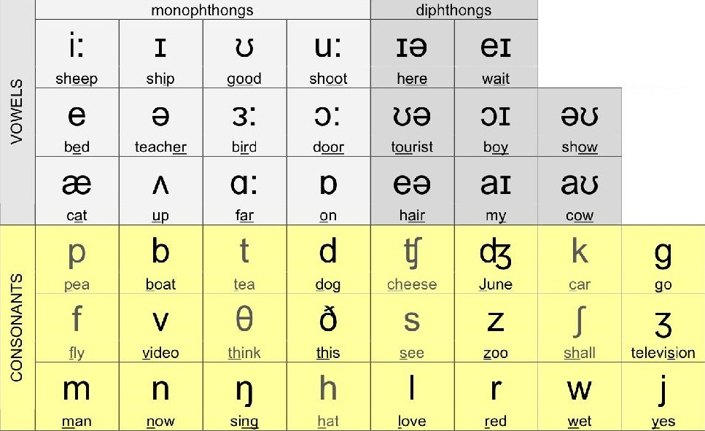
Now, lets look at the 44 sounds

Slide 5
Two types of Phonemes - Vowels and Consonants
Vowels
Vowels are musical speech sounds. They are open speech sounds.
This means, vowel sounds are made when the vocal cords and mouth remains open, as in the letter /a/, /e/, /o/ etc.
There are twelve vowel sounds in English
Consonants
Consonants are closed speech sounds, as in the air flow must be restricted at the mouth, or the throat, to produce consonants.
For example, /p/, /b/, /g/, /r/ etc.
There are 24 consonant sounds in English.

Slide 6
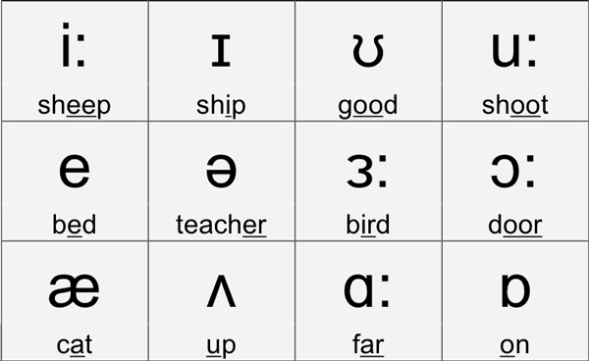
There are 12 Vowel Sounds. These twelve sounds are monophthongs. A monophthong (mono+phthongos) is a pure vowel that has the same phonic property throughout its articulation. These 12 vowel sounds combine to form 8 further vowel sounds – called diphthongs.

Slide 7
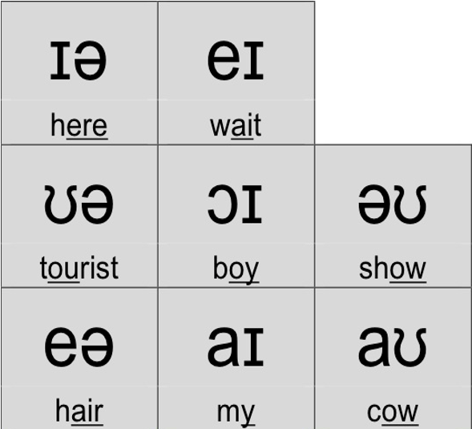
There are 8 diphthongs. (Di-phthongos) Monophthongs combine to form diphthongs. That is, diphthongs are a combination of the 12 pure vowel sounds.

Slide 8

Monophthongs Diphthongs

Slide 9
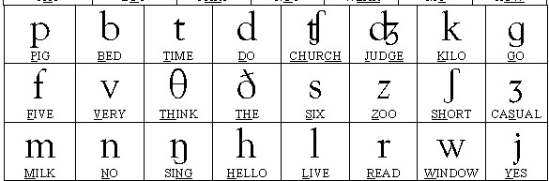
Consonants
Consonants are closed sounds.
The flow of air must be stopped either by the lips or the tongue (in some cases by the throat muscles) to create consonant sounds.
There are 24 consonants in English.

Slide 10
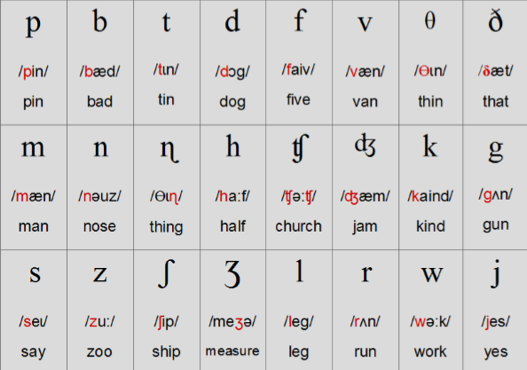
Consonants

Slide 11
The Word and its Units
A word is made up of phonemes.
Phonemes are individual units of sound.
Therefore, the smallest unit of a word or sound is the phoneme.
Phonemes combine together to form another unit within the word called a syllable.
A syllable is the number of phonemes that can be articulated in a single breath

Slide 12
Syllables
A syllable is the total number of phonemes that can be pronounced together in a single breath.
The sound that can be produced in a single breath.
The sound that can be produced in one articulation, that is, in one movement of the mouth (tongue and lips).

Slide 13
Syllables
Dog Happy Computer Information
Cat Paper Important Journalism
House Baby Confusion Engineering
Smile Maybe Collision Biology
Tight Doctor Subtraction Intimacy
Role Lawyer Incident Identity

Slide 14
Syllables Examples
Dog Hap . Py Com . Pu . Ter In . For . Ma . Tion
Cat Pa . Per Im . Por . Tant Jour . Na . Li . Sm
House Ba . By Con . Fu . Sion En . Gi . Nee . Ring
Smile May . Be Col . Li . Sion Bi . O . Lo . Gy
Tight Doc . Tor Sub . Trac . Tion In . Ti . Ma . Cy
Role Law . Yer In . Ci . Dent I . Den . Ti . Ty

Slide 15
Identifying Syllables
Syllables in the English language will always have at least one vowel sound in it.
Therefore, a method to identify the number of syllables in a word is to count the number of vowel sounds in it.
The number of vowel sounds in a word equals the number of syllables in that word.

Slide 16
Identifying Syllables
Another method of identifying syllables is the chin method
That is, place your hand under your chin and very slowly articulate (pronounce) a word.
The number of times your chin falls on your hand is the number of syllables in that word.

Slide 17
Identifying Syllables
Articulation is the process by which we use our mouth and lungs to produce phonemic sounds.
A syllable, in this way, is the number of movements of the tongue and lips (constitutent parts of our mouth) during the production of sounds.
Speak very slowly, and feel the movement of your tongue as you speak;
Feel where your tongue begins, is at rest, as the word is spoken
Feel where to the tongue moves as you keep saying the word slowly.
For e.g., say ‘s l o w l y’, feel how your tongue moves backwards as you slowly say ‘slow’, and then moves upwards and forwards as it articulates ‘ly’ .

Slide 18

Word Stress
To communicate clearly when we speak English, it is important to stress the correct syllables in each word.
This is called word stress.
Stress means pronouncing one syllable of a multisyllabic word with greater emphasis (stress) than the other syllables in the word.

Slide 19
Word Stress Exercise
English
Europe
Ganga
Tiger
Handsome
Careful
Arrive
Explain
Forget
Respond
Decide
Repeat

Slide 20
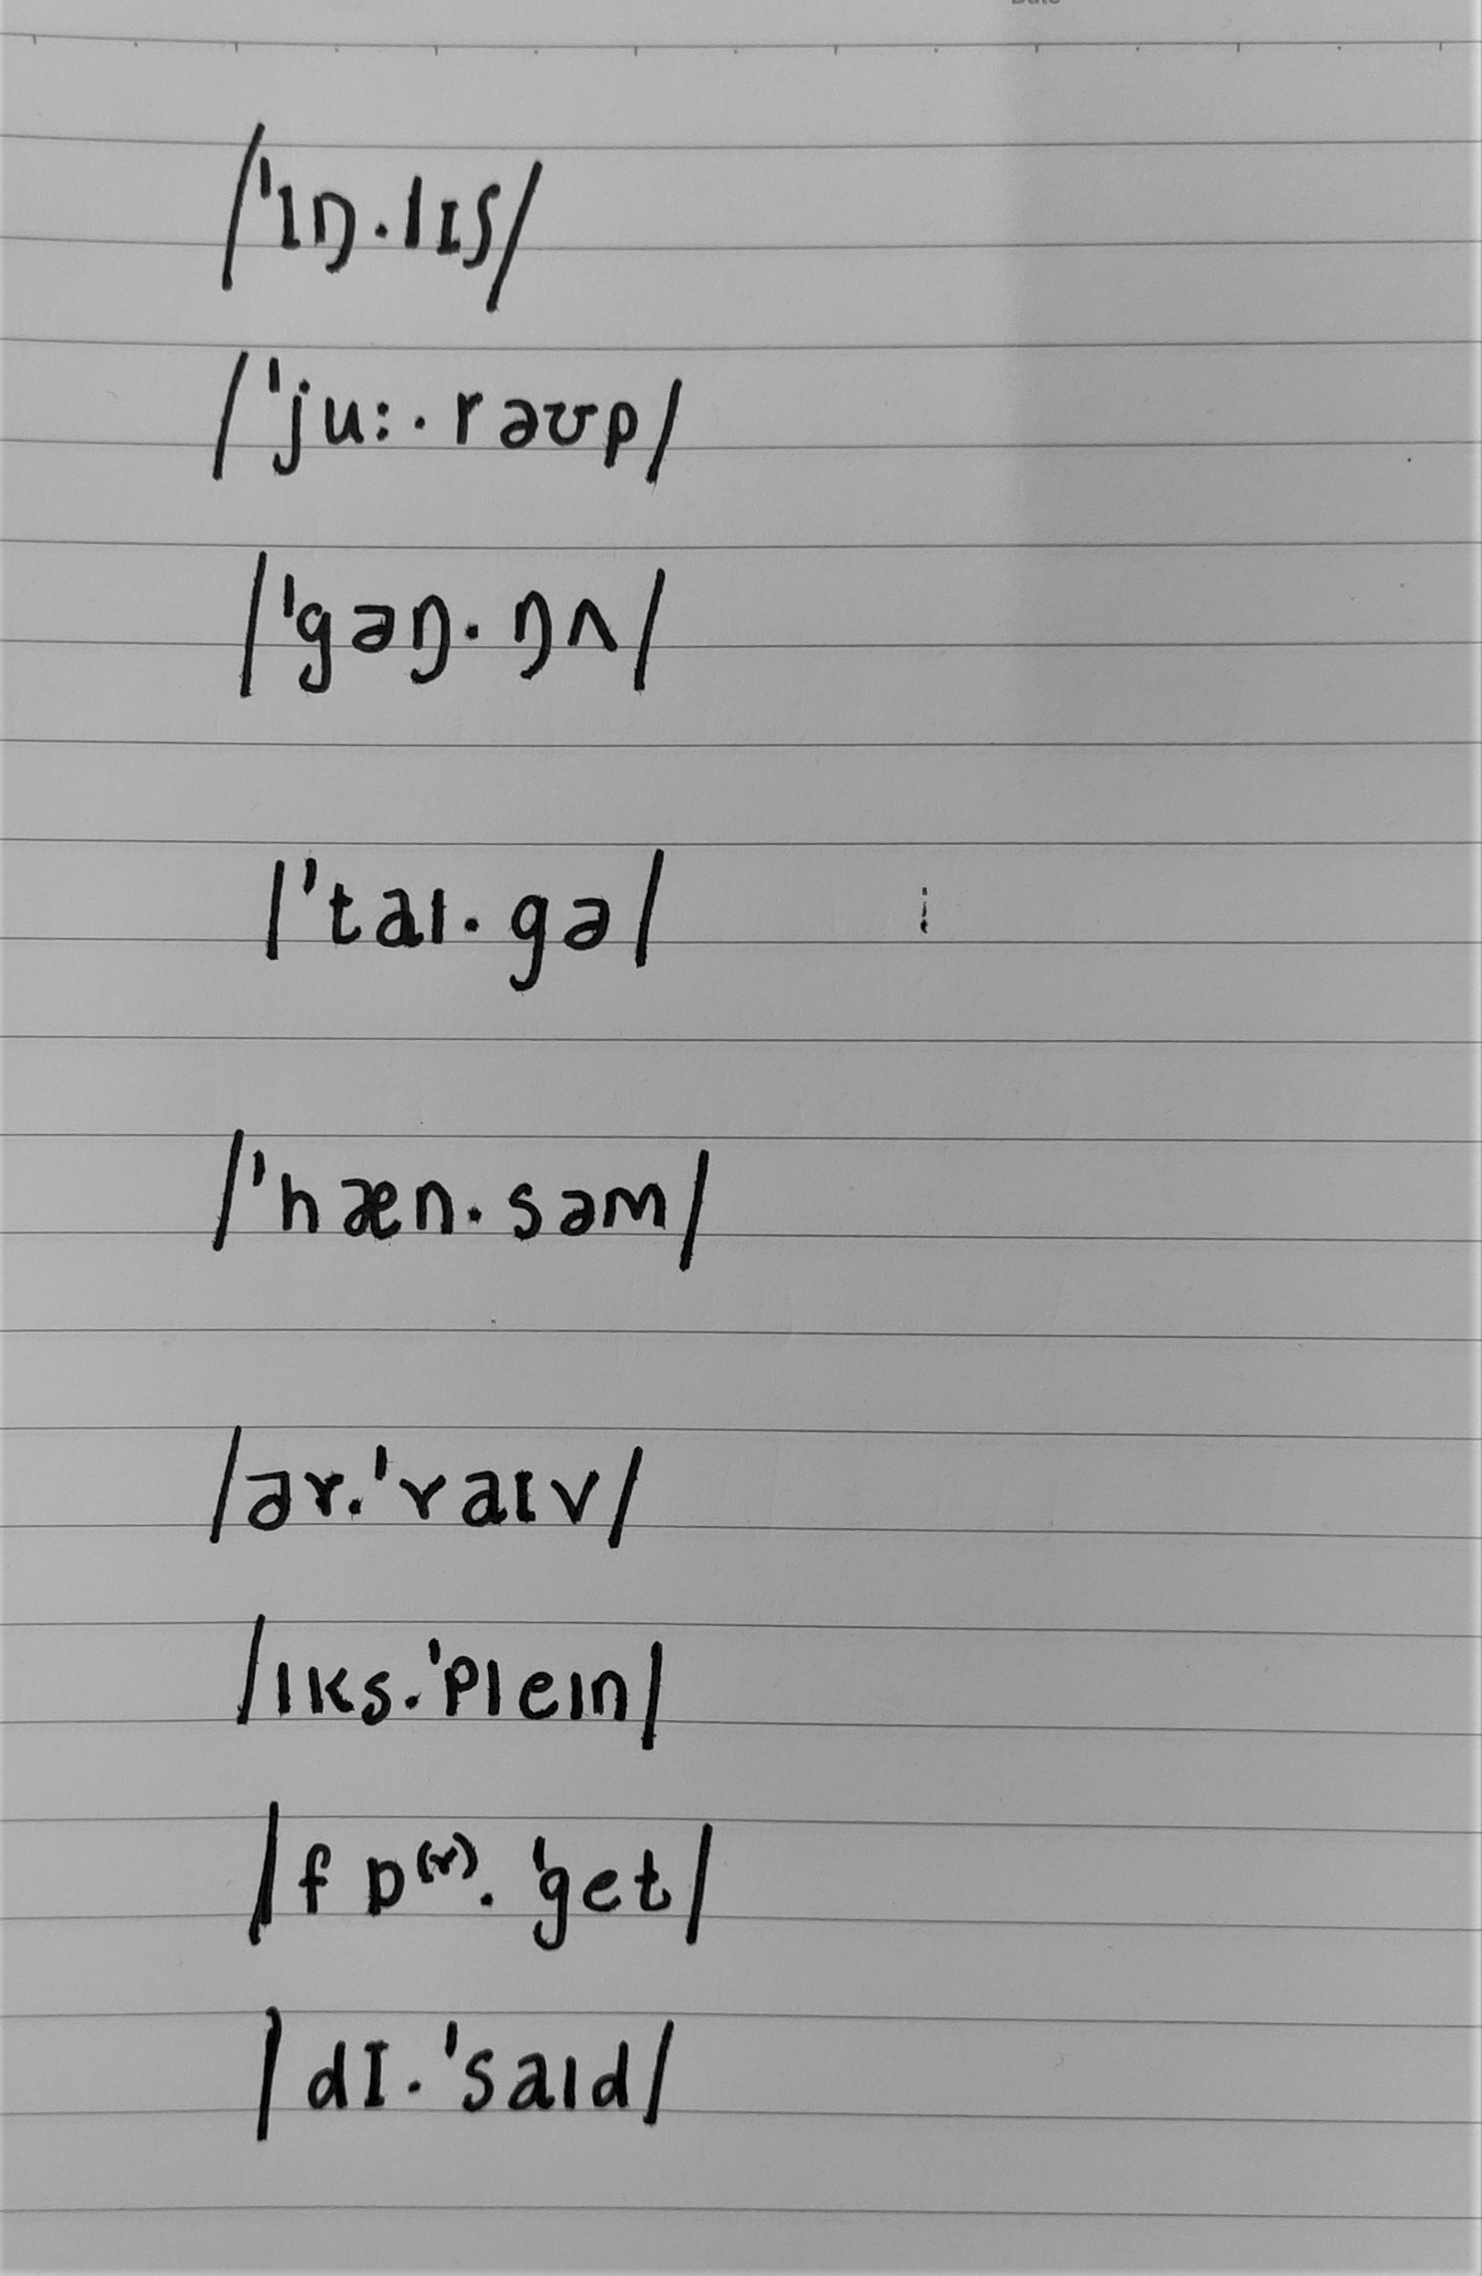
Word Stress - Transcribed

Slide 21
Word Stress Rule 1 – Disyllabic Words
If the word is disyllabic, and is a:
Noun or Adjective – Stress is generally on first syllable
Verb – Stress is generally on second syllable
This rule is not definite, and there are plenty of exceptions to this rule.

Slide 22
Rule 2 – Trisyllabic Words No Rule (Stress can be on any syllable)
‘A.ny.one
‘Beau.ti.ful
‘Pos.si.ble
Com.’pu.ter
To.’mor.row
Ex.’pen.sive
Less Common
Af.ter.’noon
Em.plo.’yee
Ja.pa.’nese

Slide 23
Rule 3 – Longer Words are stressed in the middle
In.for.’ma.tion
Dis.’cus.sion
Po.li.’ti.cian
Si.tu.’a.tion
Re.’vi.sion
E.lec.’tri.cian
E.co.’no.mic
Dra.’ma.tic
Scien.’ti.fic
In words ending with:
-tion
-sion
-cian
-ic
Stress is always on the second to last syllable
(syllable before the last syllable)

Slide 24
Rule 4 – Words ending in ‘–y’
Bi.’o.lo.gy
‘Lu.cki.ly
Ac.’ti.vi.ty
Pos.si.’bi.li.ty
‘Che.mis.try
‘Preg.nan.cy
‘Rob.be.ry
If a word ends in ‘-y’,
Stressed syllable is two syllables before the last one

Slide 25
Rule 5
‘Com.fort
‘Com.for.ta.ble
Dis.’com.fort
Un.’com.for.ta.ble
‘Com.for.ta.bly
‘Comfort’ is the root word
Other words are made using this root word
In this case, stress is always on the syllable originally stressed in the root word.

